Slide 1
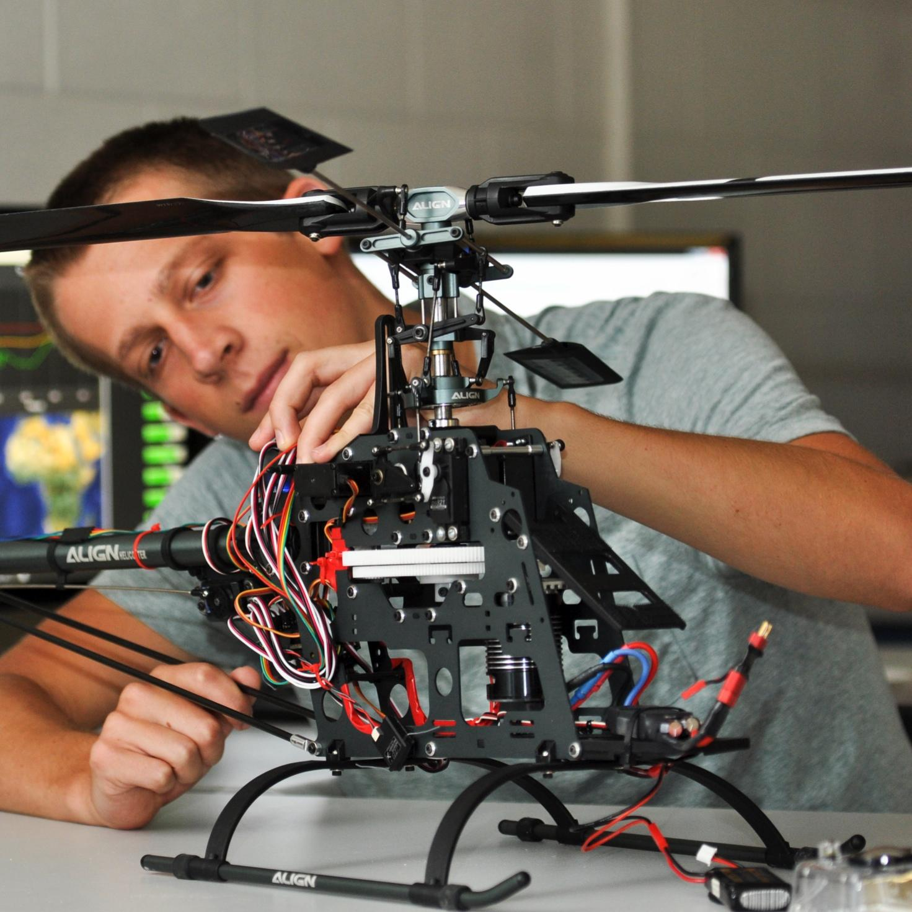

TMEIC DI-Water Cooling Skid
Bi-Weekly Update 5
Ethan Henderson
Robert Parker
Noah Ovikian
Sponsor: TMEIC
TA: Jerry Xu
Notes:
Michelle

Slide 2
Project Summary
Problem Statement
TMEIC’s high-power VFDs rely on deionized-water cooling to protect inverter IGBTs from damaging heat. Using a full-scale cooling system for customer training is costly, cumbersome, and impractical, yet trainees still need realistic operating and troubleshooting scenarios.
Our Solution
We are designing and building a compact, temperature-controlled DI water cooling skid for TMEIC’s training facility. It will reproduce the behavior of the full-scale system, enabling accurate hands-on testing, diagnostics, and troubleshooting at a fraction of the scale, cost, and complexity.

Slide 3
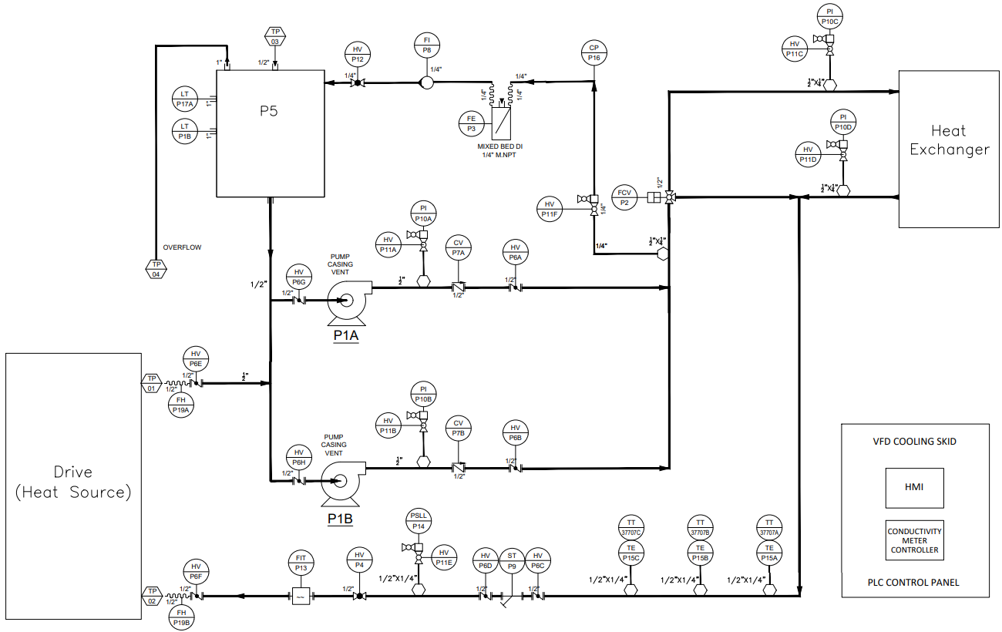
Project Summary

Slide 4
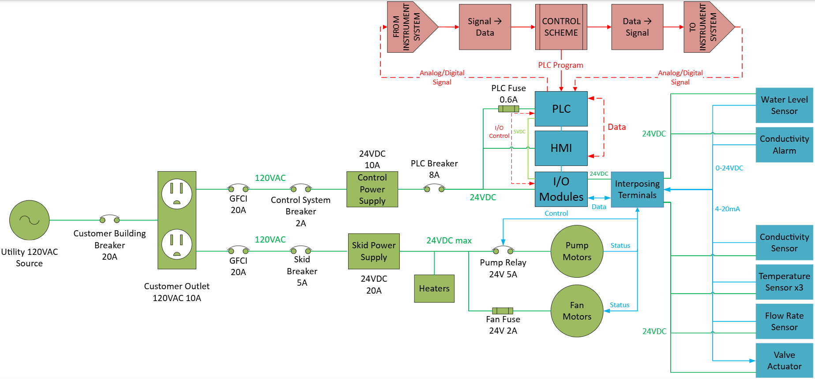
System Overview
Ethan Henderson
Robert Parker
Noah Ovikian

Slide 5
Phase IV Timeline
OCT 5
Phase I Complete
OCT 18
Phase III Complete
NOV 5 - NOV 26
Full Skid Test
OCT 15
OCT 19
OCT 5
OCT 15
Phase II Complete
OCT 18
OCT 19 - NOV 5
Full Skid Assembly + PLC Mounting
NOV 5
Complete
In Progress
Behind Schedule
Not Started
*Contains AI generated content*

Slide 6
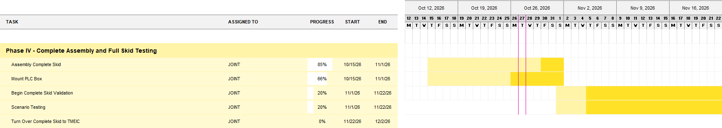
Execution Plan

Slide 7
Full Skid Assembly

Slide 8
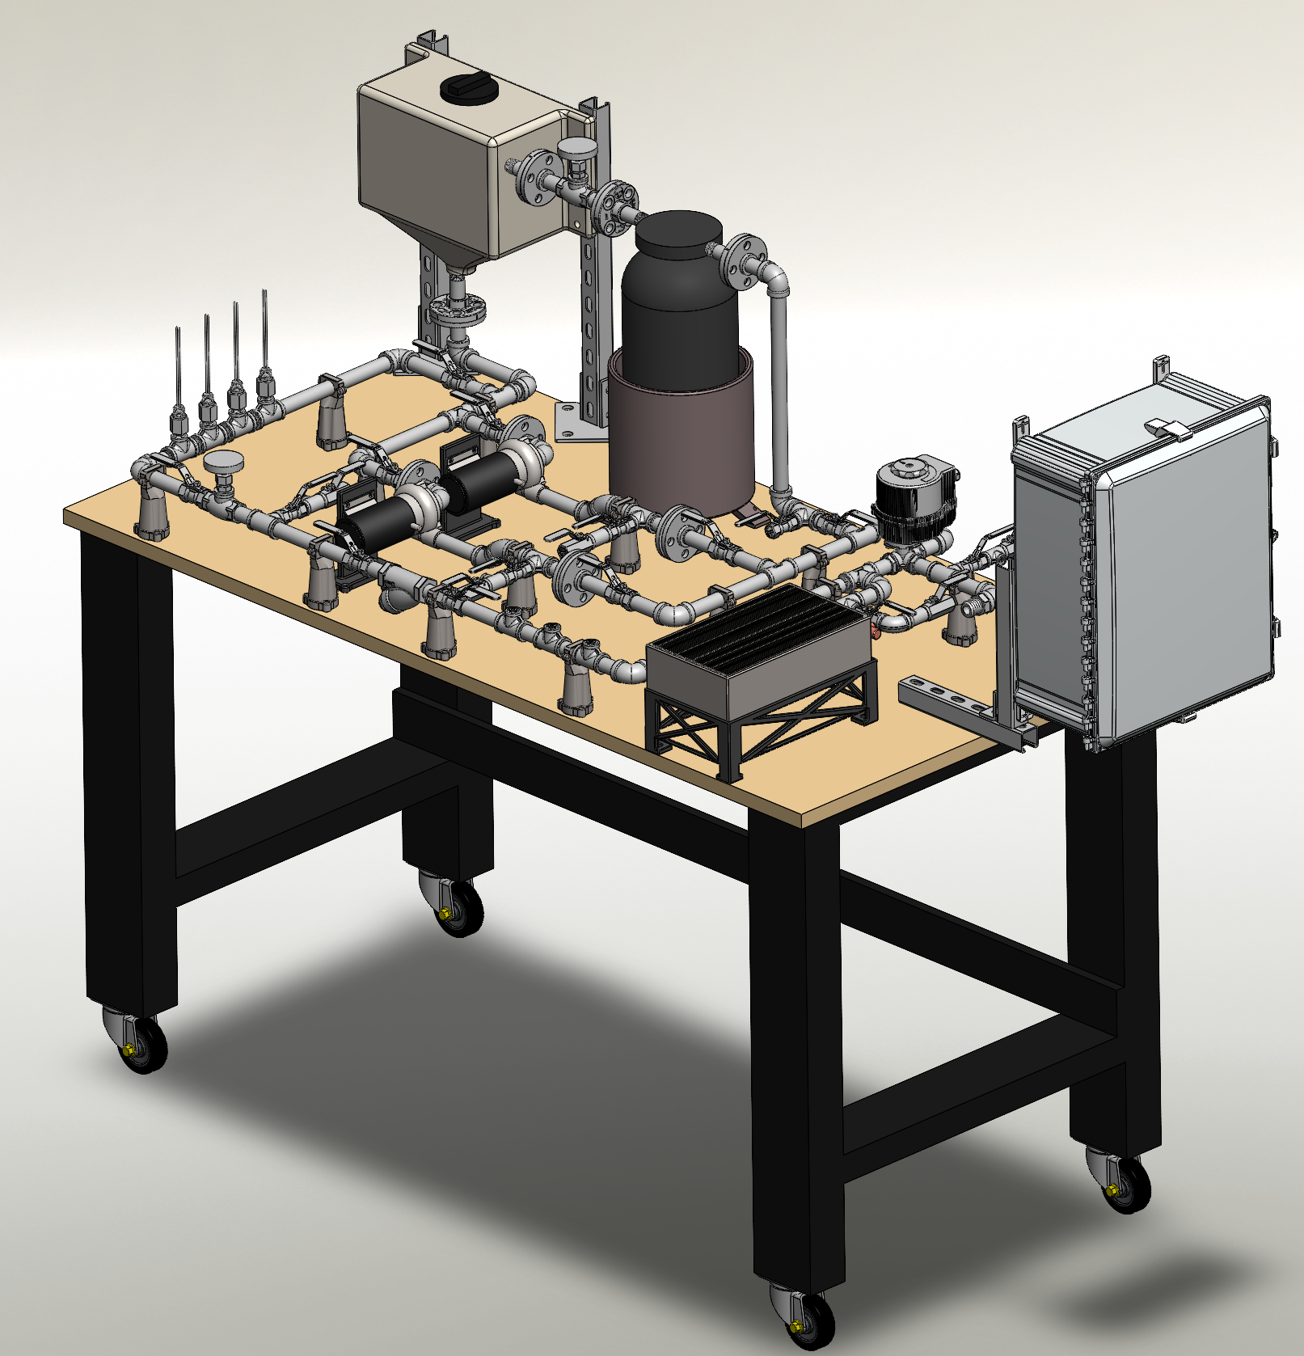
Full Skid Assembly

Slide 9
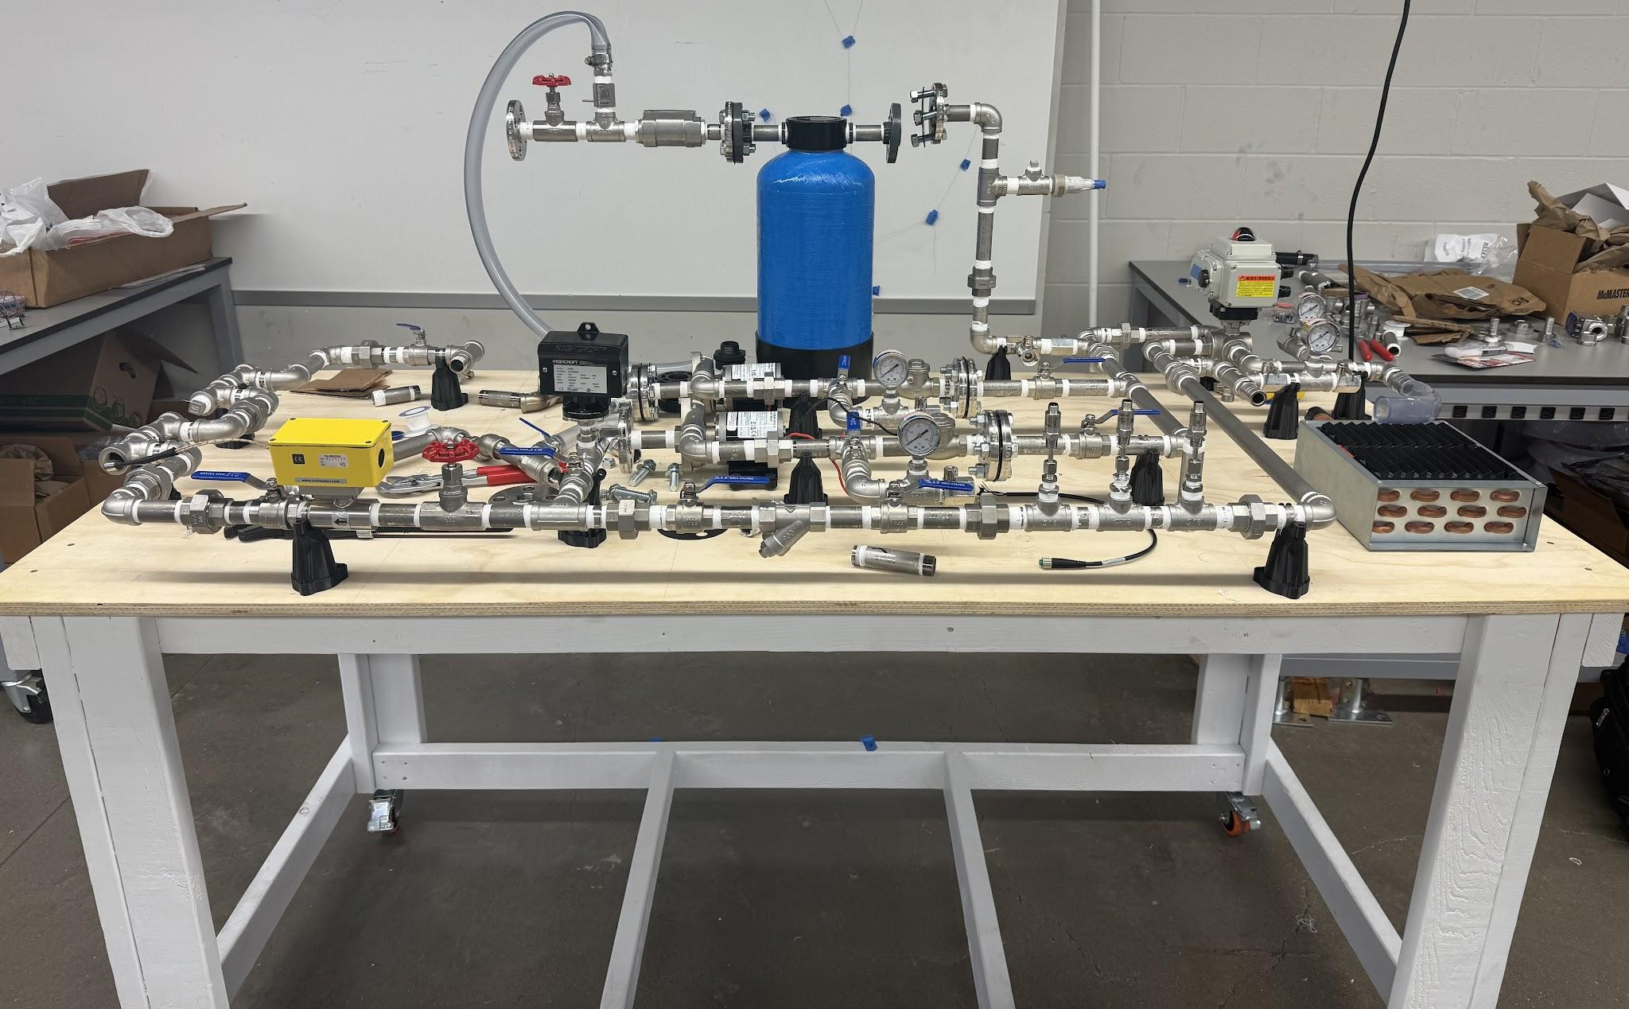
Full Skid Assembly
Water Reservoir
Heaters (x2)
Flow Transmitter
Pressure Switch
Pump (x2)
RTD (x3)
Conductivity Probe
Three-Way Valve
PLC Box

Slide 10
Power | ECEN Team Lead | PLC Mounting
Ethan Henderson
Time Spent: ~20 Hrs
Accomplishments (10/14 - 10/28) | In Progress (10/28 - 11/11)
Ordered mounting and organizational components - received half second half was turned away by TAMU - reason unknown at this time V1 of CAD model finished Developing footprint plan for wire and conduit sizing Coordinated w/ MEEN TL to establish delivery date and TMEIC site visit - Dec 1, 11:00 a.m. Finalized protection scheme for skid - oneline pending Added 2A Type C breaker for three-way valve Added 600mA fuse for HMI controls Added 4A Type C breaker for additional 20A supply Finalized wire gauge sizing for skid and PLC box Power (120VAC/24VDC 1-6ADC) - 14 AWG Al or Cu Control (24VDC 0-1ADC) - 16 AWG Cu Finalized grounding plan | Continue working to provide clarity on project-class requirements and expectations - video & report Mount current layout to Al backplate using M4-7 cap screw + nut Update CAD amidst lessons learned from first mounts Establish exact lengths of conduit, PVC casing, and wires and order the items - PVC and conduit already en route Size an install circulating fans for cooling Run full-load test - the goal is to stress the protection devices to watch for nuisance trips Cap in-rush for power supplies LRA for pump and three-way valve motor start Total draw from heating elements

Slide 11
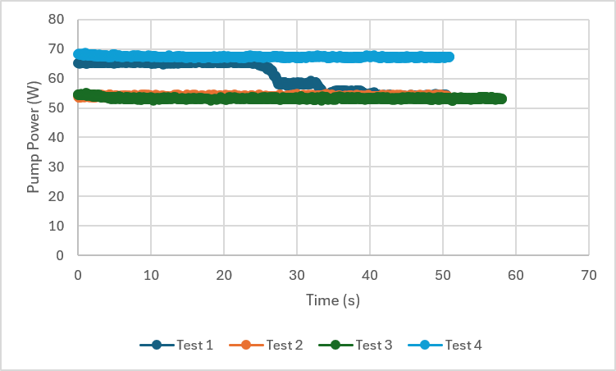
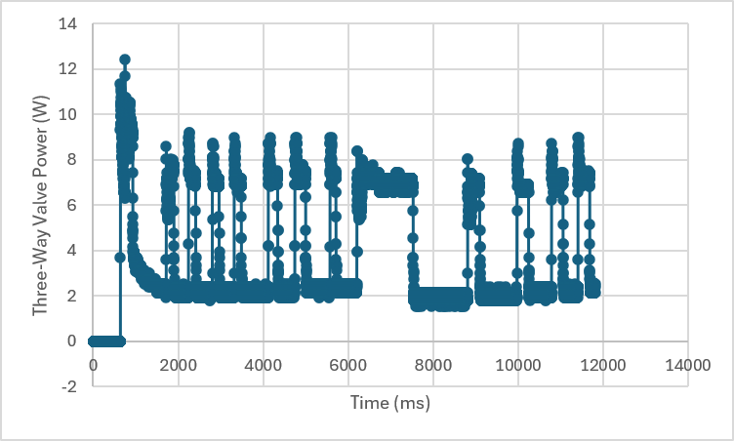
Power
Expected outcome for pump power (left) is stable and constant operation irrespective of loading condition.
Expected outcome for 3-way valve (right) is no nuisance trips during quick actuation.

Slide 12
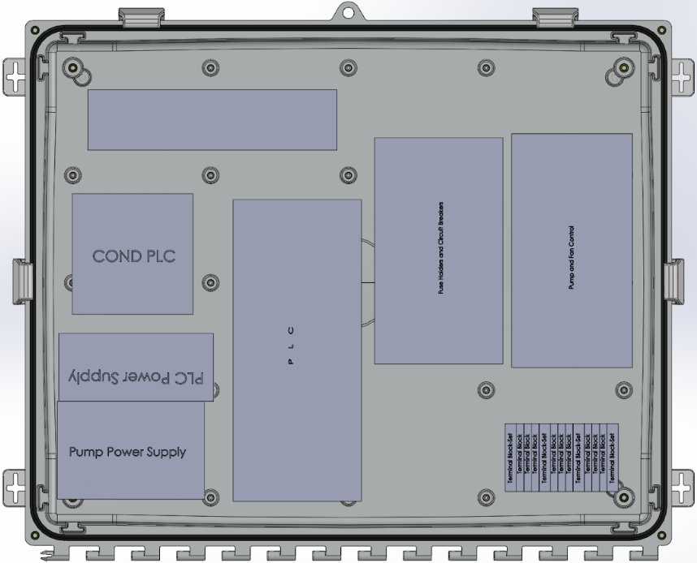
PLC Mounting
The strategy is to take rectangular measurements of every component and use the CAD to put the pieces together to determine best orientation/configuration of components, conduit termination, and wiring.

Slide 13
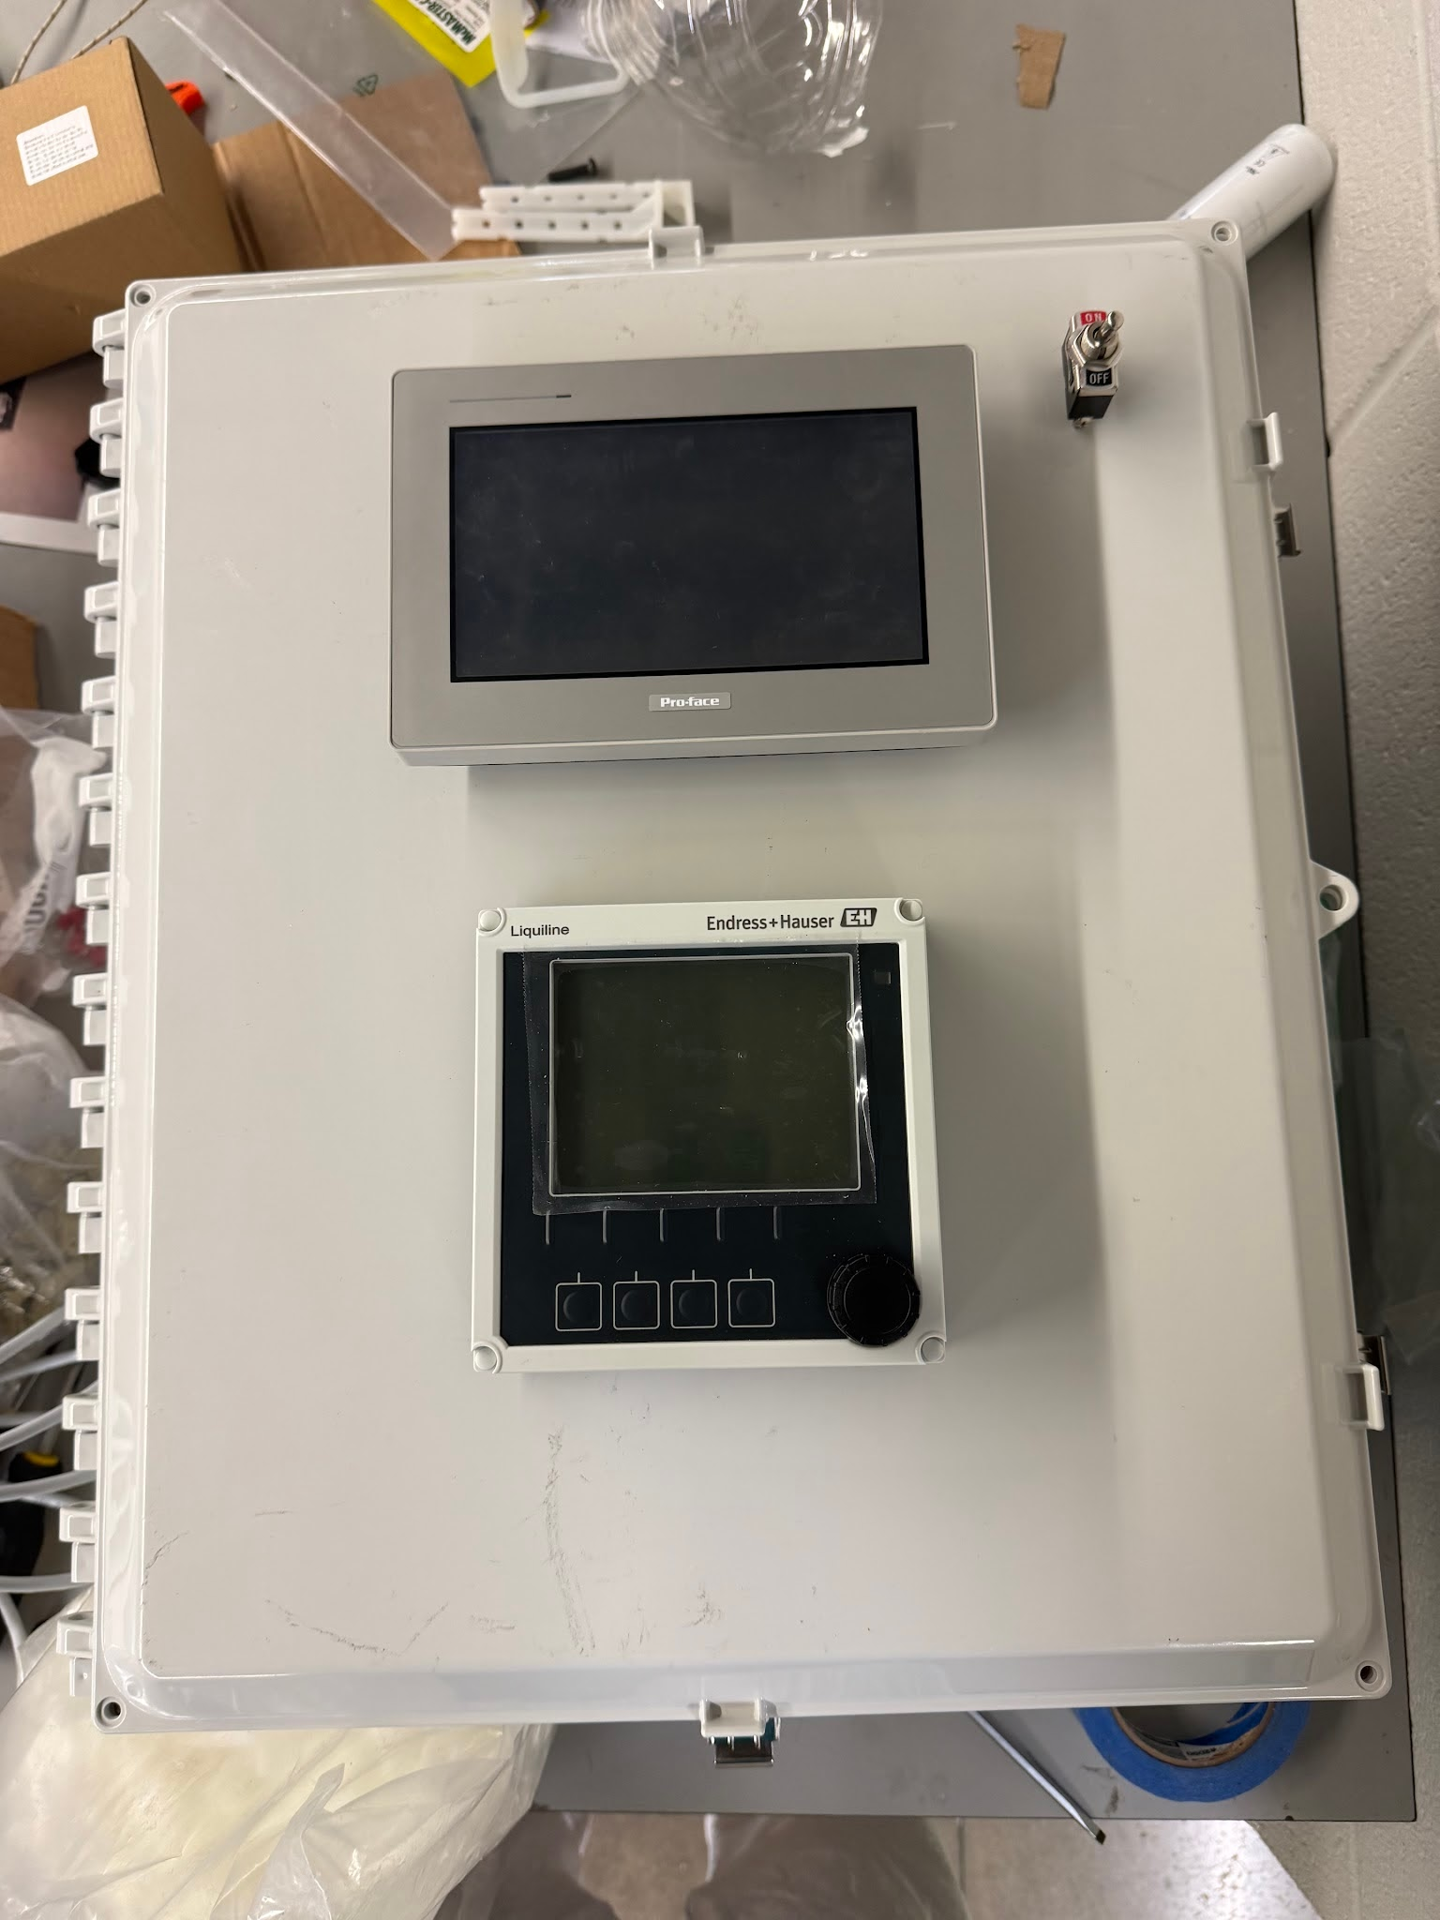
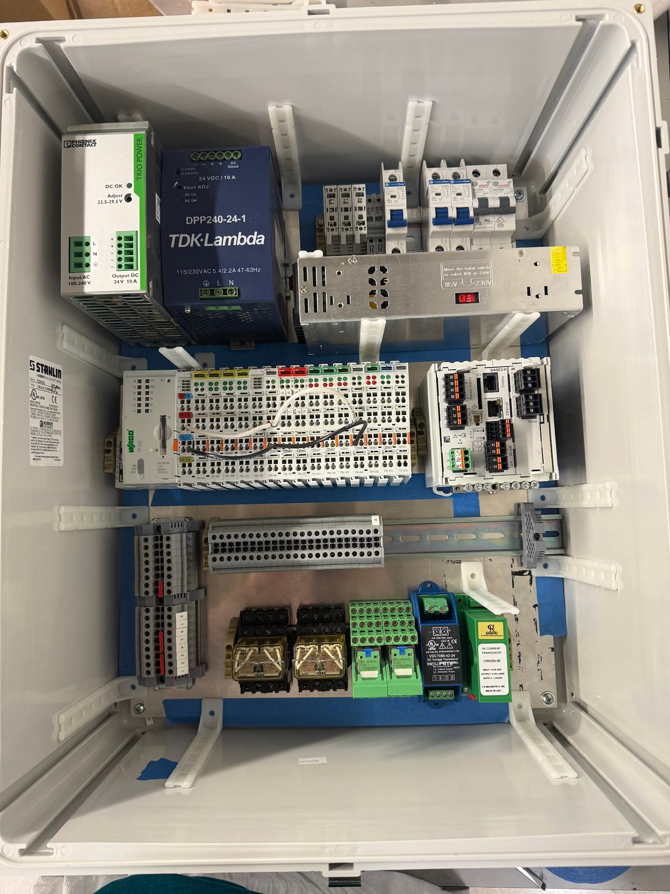
PLC Mounting
(Right) - We want to segment different “categories” of the overall electrical system (i.e. AC input, DC power + protection, and instrumentation and controls) using the wire ducts (part of the turned away package)
(Left) - HMI will be in most convenient location for operation along with Main Power Switch
Main Power Switch
HMI
Conductivity
HMI

Slide 14
Instrumentation & Control
Robert Parker & Noah Ovikian
Combined Time Spent: ~40 Hrs
Accomplishments (10/14 - 10/28) | In Progress (10/28 - 11/11)
Flow Transmitter Installed, Tested, Collected Data Designed 1st Order Digital Low Pass Filter Conductivity Transmitter Tested w/ Resin Bed Collected Data Designed 1st Order Digital Low Pass FIlter Wiring Determined Wiring Color Scheme | Temperature Regulation Implement & Tune PI Controller Execute Temperature Regulation Validation General System Validation Execute Pump Turnover Validation Finalize Manual Control Validation Finalize Startup/Shutdown Validation Finalize Measurement Accuracy Validation Initiate Sensor Failure & Fault Validation Collect Validation Data

Slide 15
Instrumentation & Control
Wire Color Standard
DC Supply +
DC Supply -
Digital In
Digital Out
Analog In
Analog Out
RTD +
RTD -
AC Line
AC Neutral
AC Ground
Table I&C.1: Table of Wire Colors (White Triangles represent striped)

Slide 16
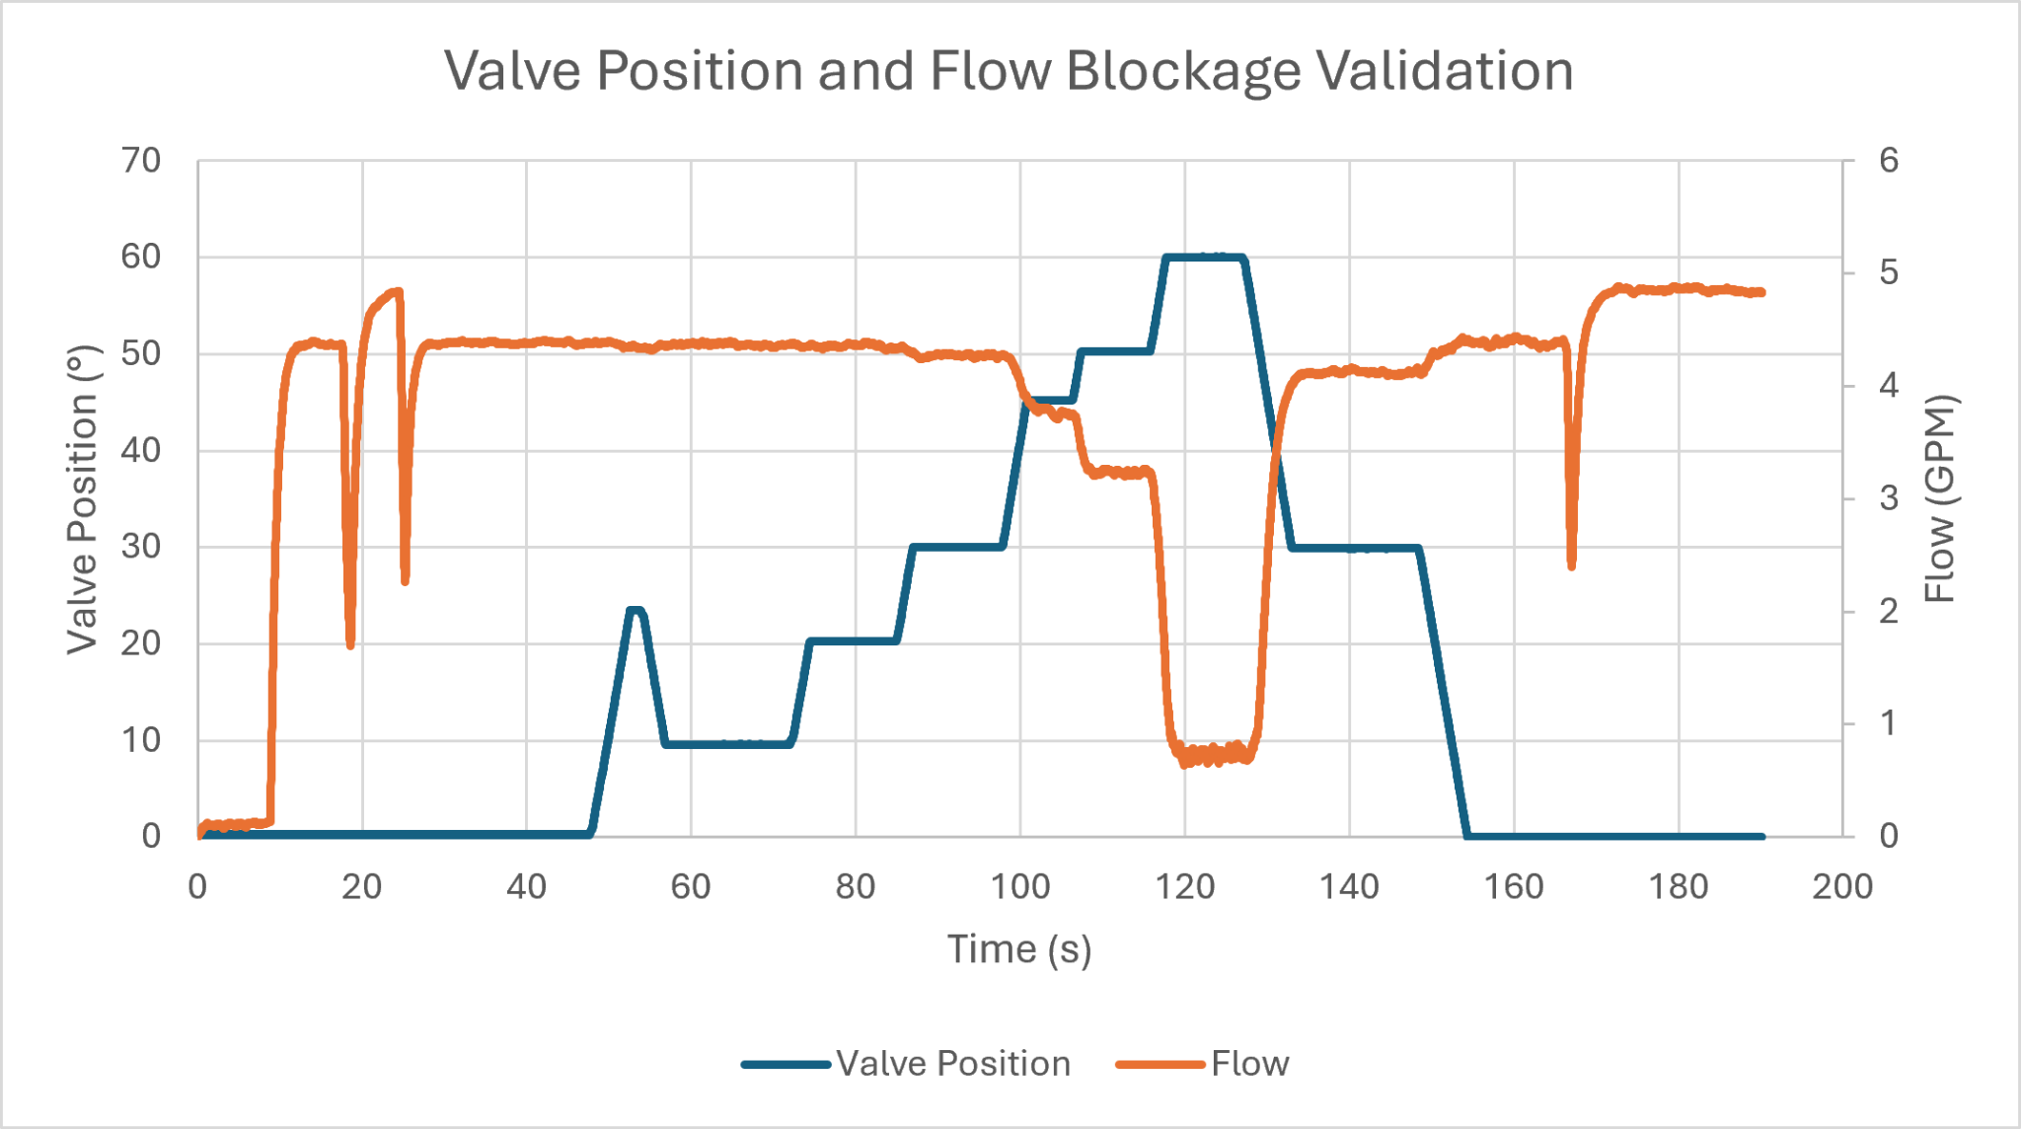
Instrumentation & Control
Flow Transmitter Test
Figure I&C.1: Plot of Valve Position and Flow rate Test

Slide 17
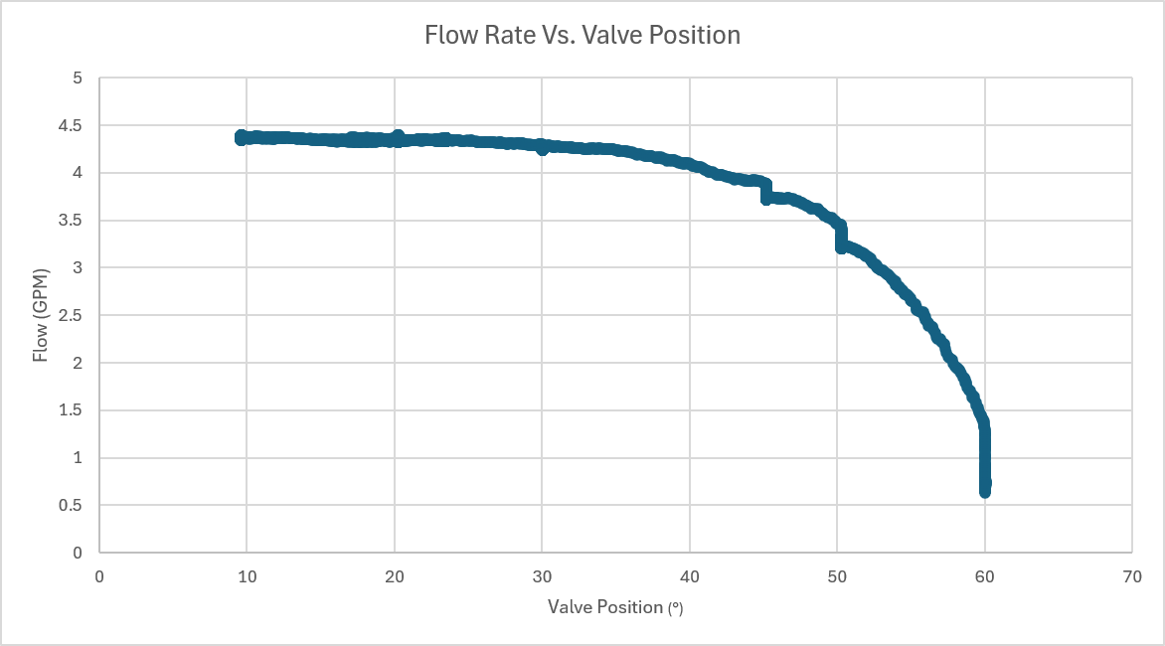
Instrumentation & Control
Flow and Valve Position Relationship
Figure I&C.2: Plot Showing the relationship between Valve Position and Flow Rate

Slide 18
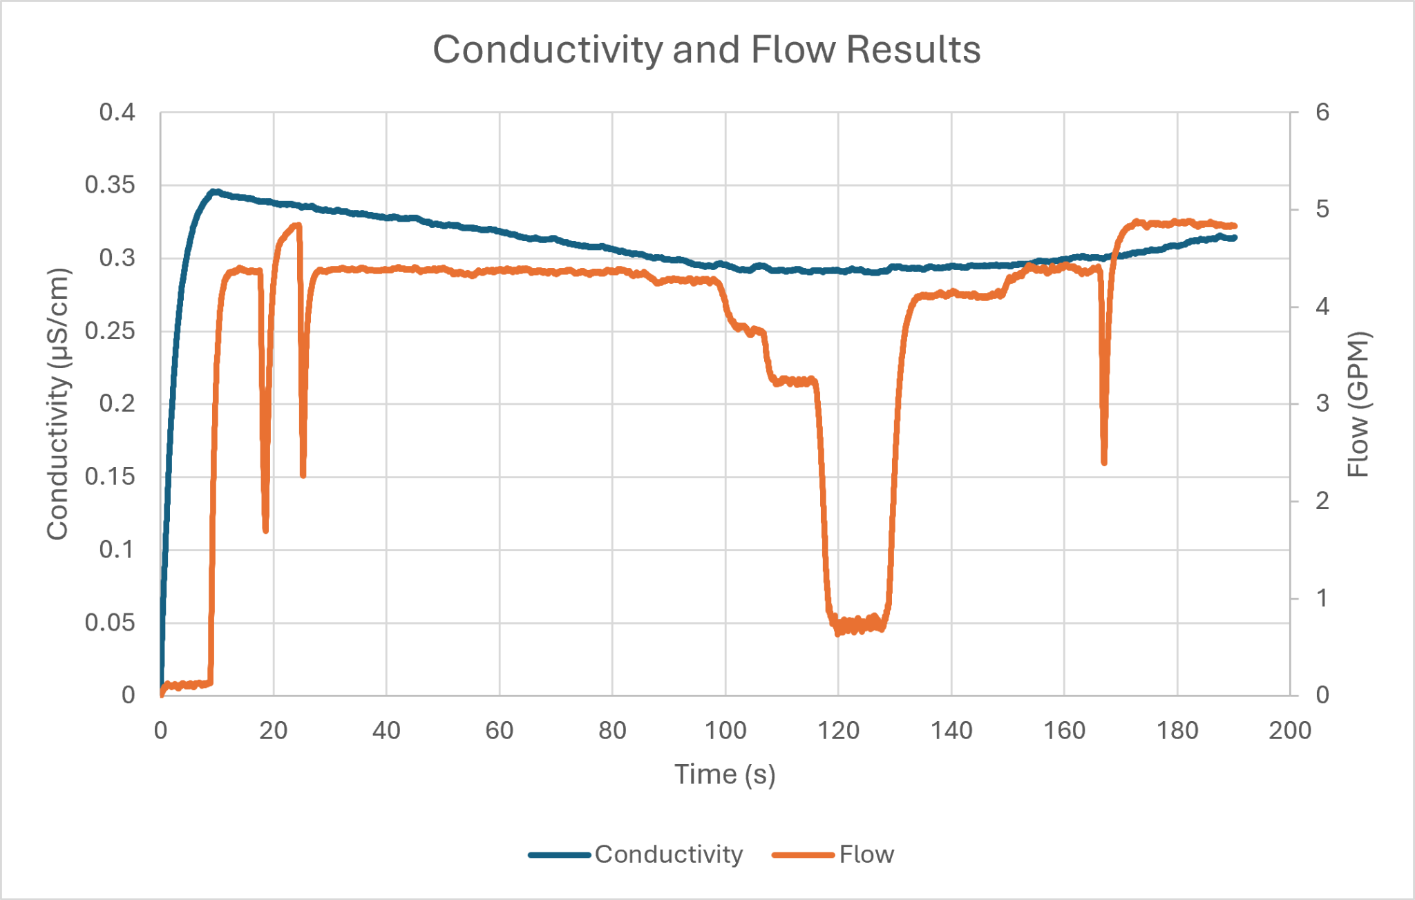
Instrumentation & Control
Conductivity And Flow Test Results
Figure I&C.3: Results of Conductivity and Flow rate test

Slide 19

Instrumentation & Control
Conductivity And Flow Test Results
Figure I&C.4: Conductivity Transmitter HMI Showing Conductivity Dropping as Water is Run Through the Resin Filter

Slide 20
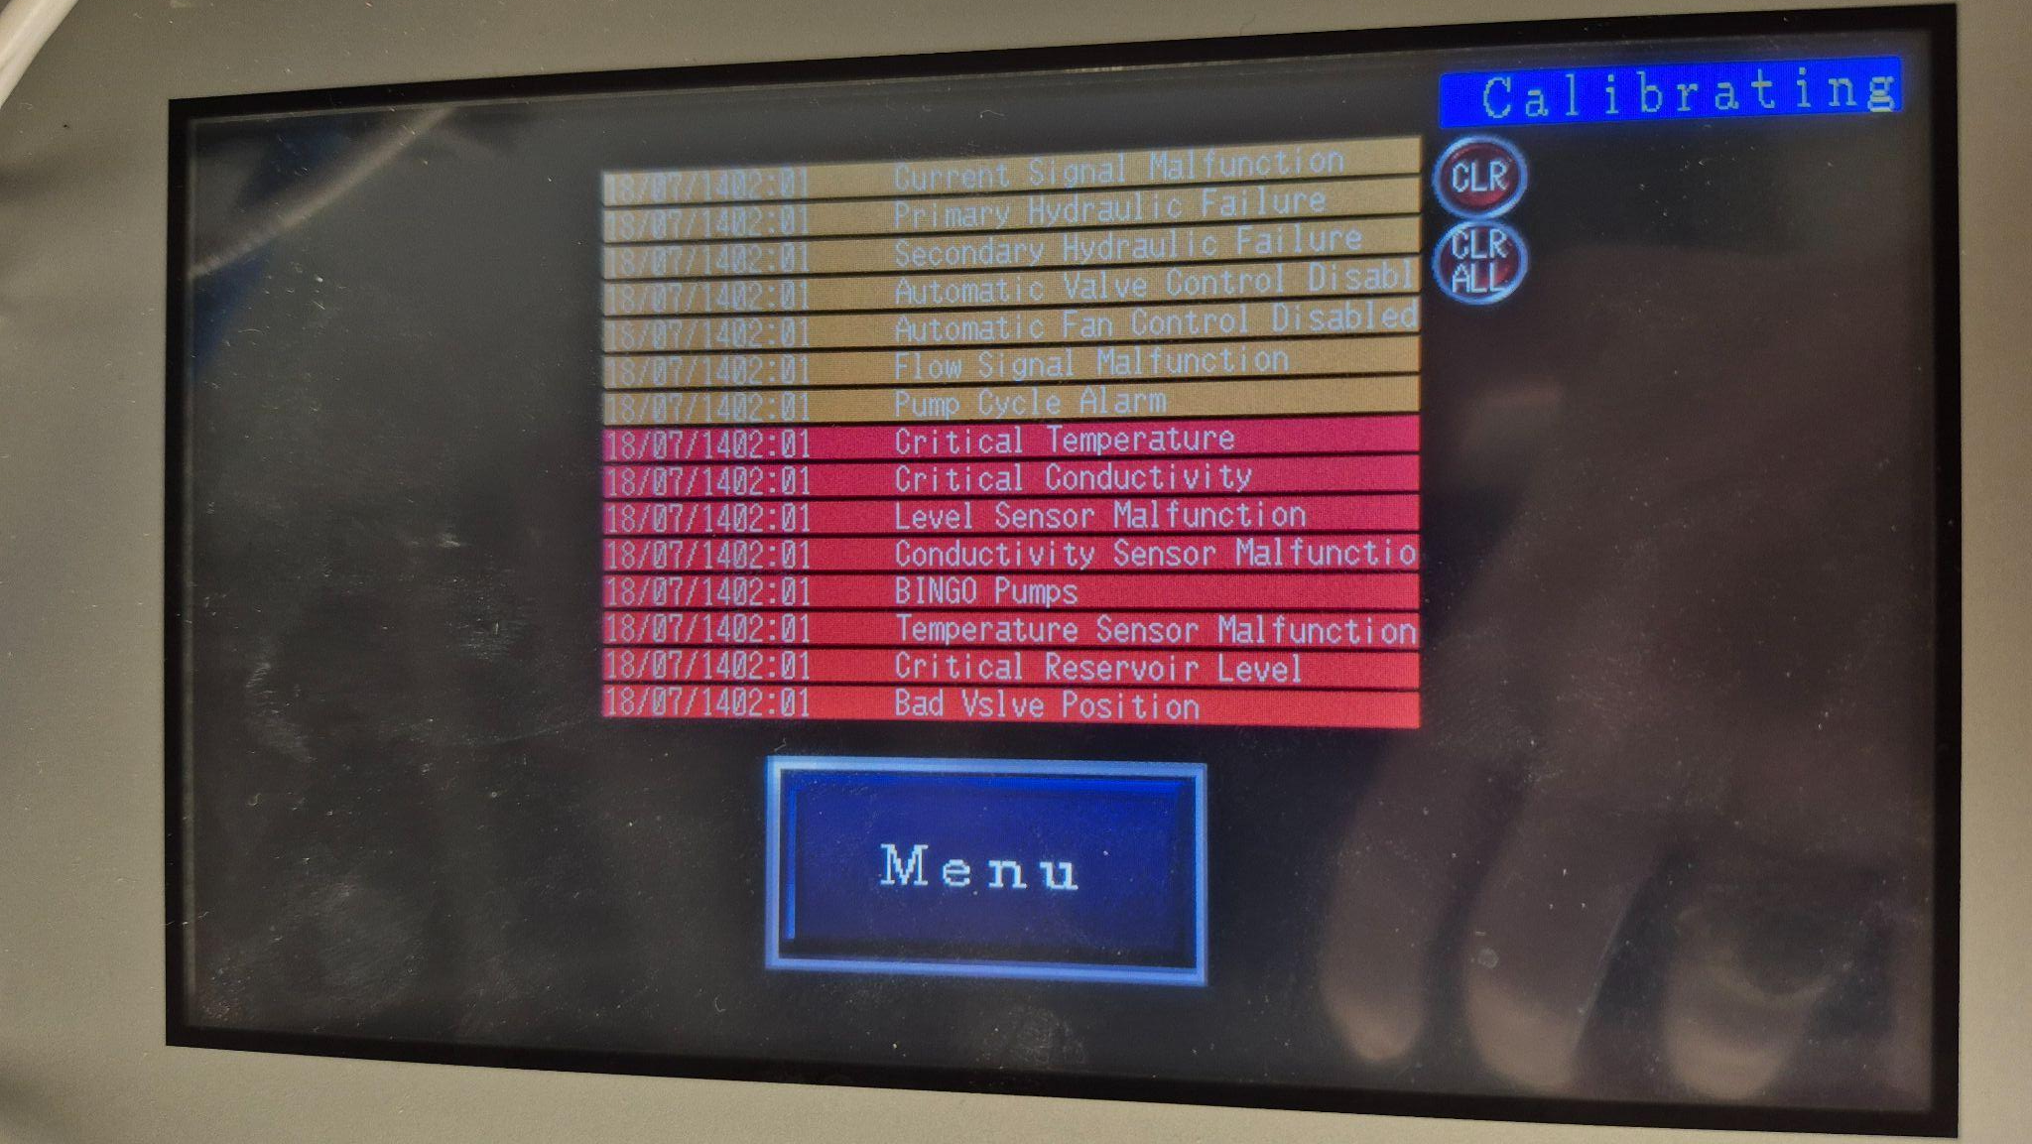
Instrumentation & Control
HMI Screen Update
Figure I&C.5: HMI Alarms Screen Showing System alarms(Orange) and System Faults (Red)

Slide 21
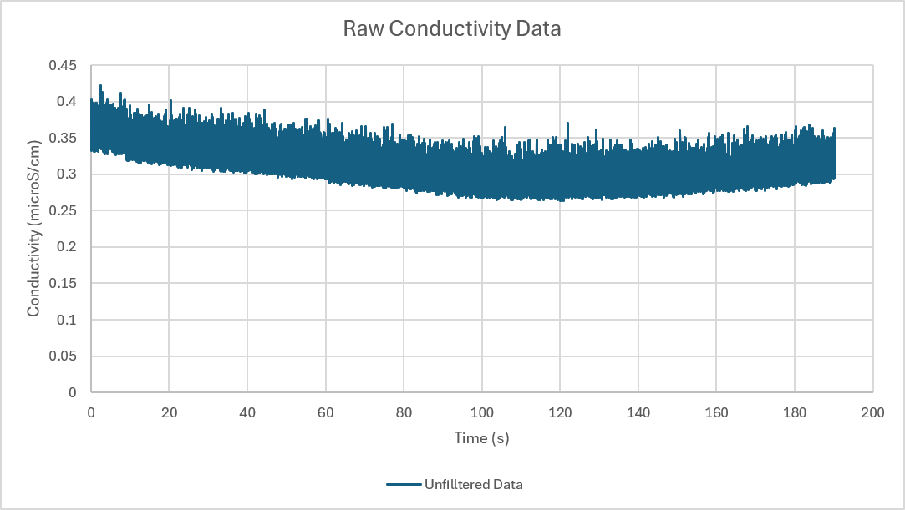
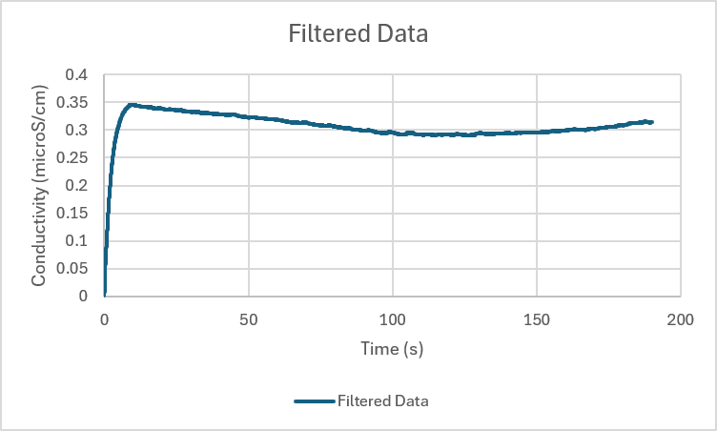
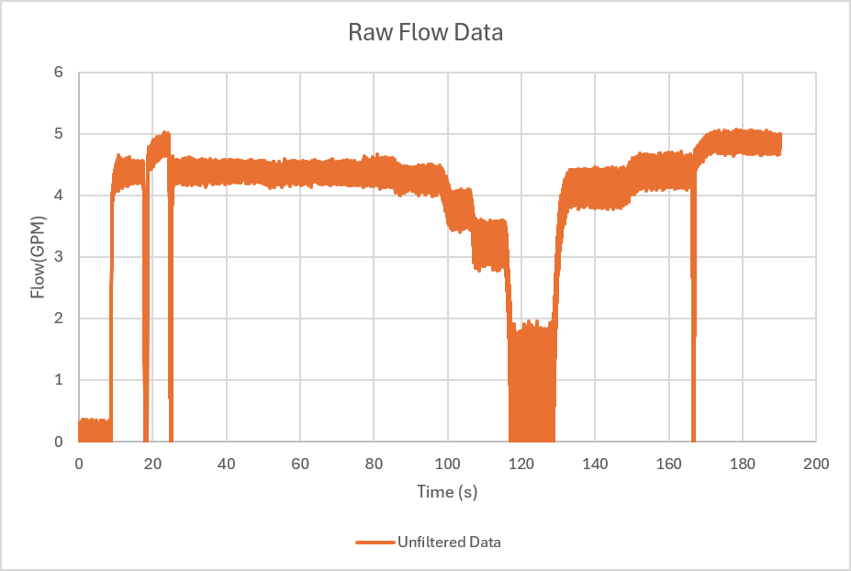
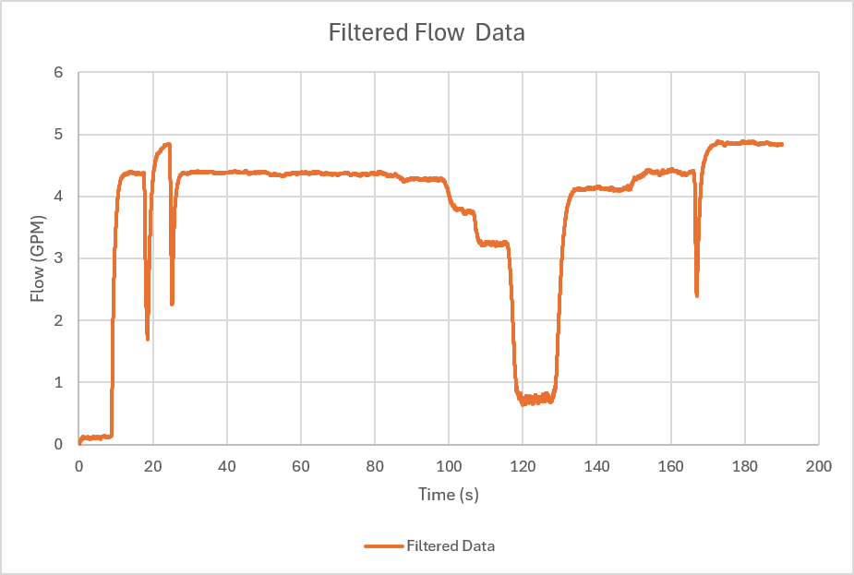
Instrumentation & Control
1st Order Low Pass Filter
Improving Instrument Precision
Noisy Raw Data = Unreliable Readings
1st LP Filter Designed Post Mortem
Discrete Equation:
  y[n] = α*y[n-1] + (1-α)*x[n]
  Where parameter α ∈ (0,1)
Flow α ← 0.98
Conductivity α ← 0.995
Figure I&C.6: Side by side of raw (left) and filtered (right) data, from conductivity (top) and flow (bottom) sensors

Slide 22
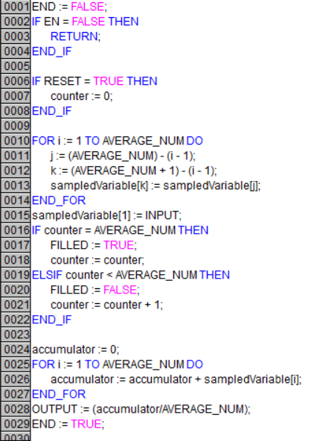
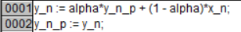
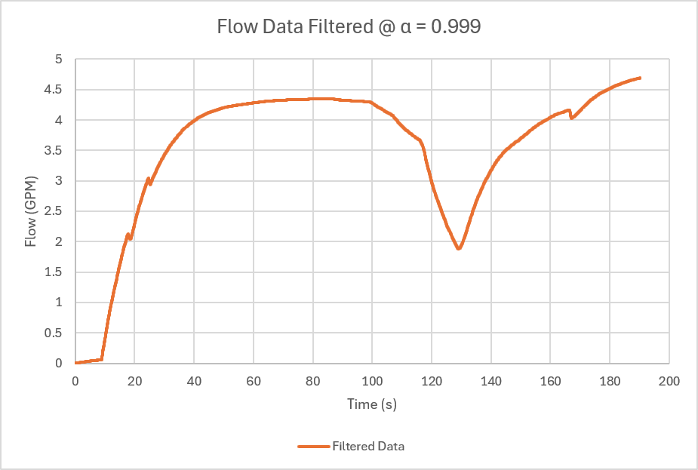
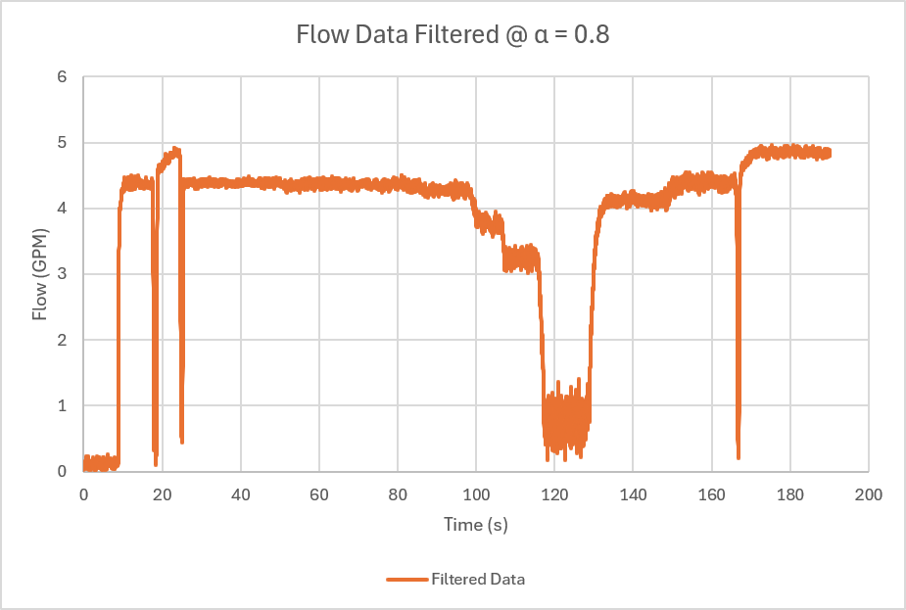
Instrumentation & Control
1st Order Low Pass Filter
1st Order Low Pass
Moving Average
Design Considerations
vs
Why Not Moving Average?
  Complex Implementation
  Greater Memory Consumed
Choosing an α :
  Too high α destroys data (over-smoothing)
  Too low α retains too much noise
Balancing Simplicity, Noise Reduction & Data Integrity
Figure I&C.7: (Top) Moving Average Implementation Requires Greater Computation, and Memory when compared to low pass digital filter. (Bottom), increase alpha smoothes data at the cost of integrity

Slide 23
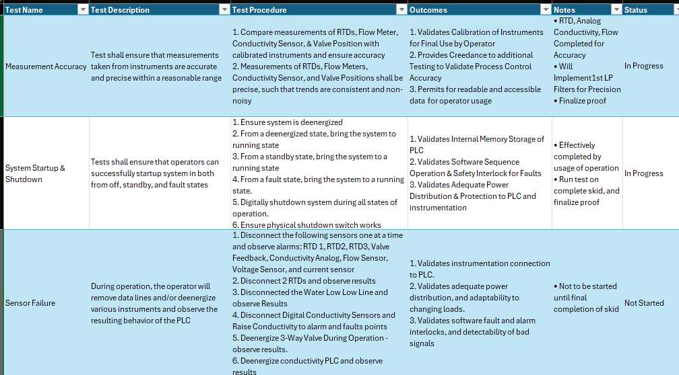
Instrumentation & Control
Validation Plan
Figure I&C.8: Validation Plan Snippet: Validate total system response with respect to Measurement Accuracy, System Startup/Shutdown, and Sensor Failures

Slide 24
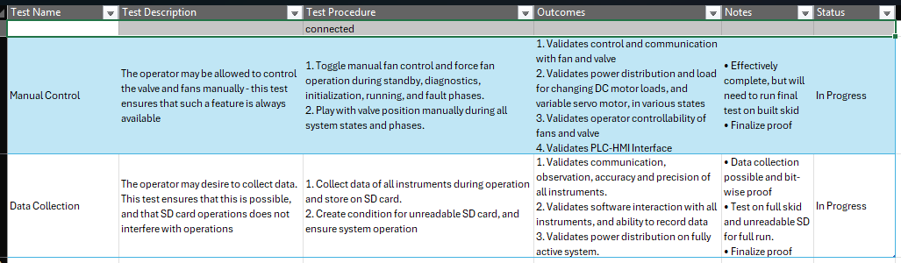
Instrumentation & Control
Validation Plan
Figure I&C.9: Validation Plan Snippet: Verify total system response with respect to manual control and data collection

Slide 25
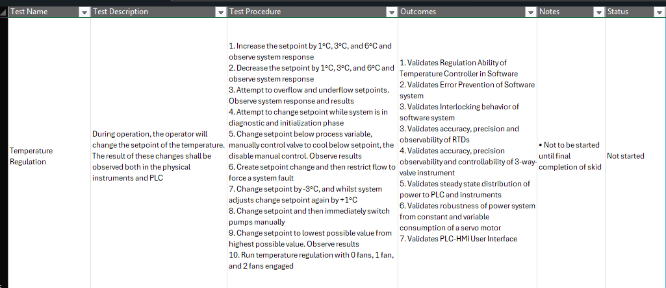
Instrumentation & Control
Validation Plan
Figure I&C.10: Validation Plan Snippet: Validate total system response with respect to temperature regulation

Slide 26
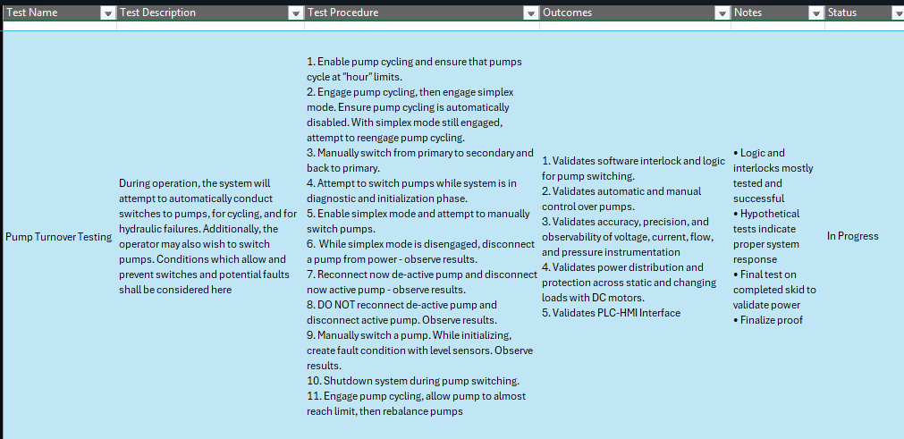
Instrumentation & Control
Validation Plan
Figure I&C.11: Validation Plan Snippet: Validate total system response with respect to pump turnovers

Slide 27
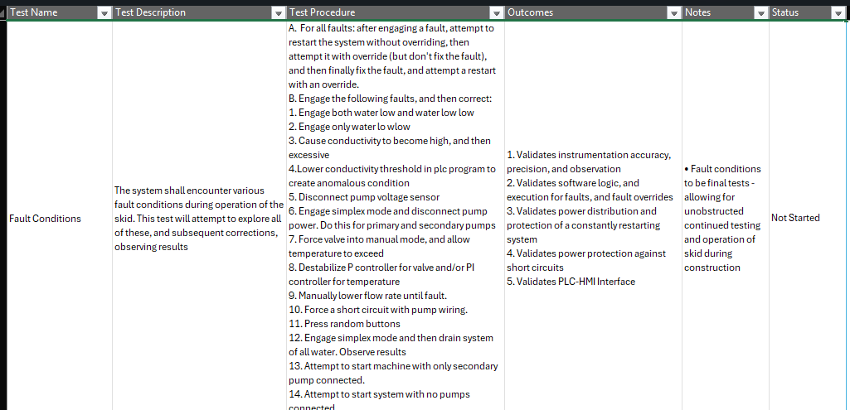
Instrumentation & Control
Validation Plan
Figure I&C.12: Validation Plan Snippet: Verify total system response with respect to temperature regulation

Slide 28
Thank You

